Slide 1
Forecasting Currency Exchange Rate
Team 3:
Sri Mourya Dommeti
Vishaka Balasubramanian Sekar
Nithin Vasudevan
Mose Yoloye

Slide 2
Agenda
Background
Goals
Data & Set-up
Results
Conclusions & Future Recommendations
Demo
Notes:
Vishaka

Slide 3
Background
Forecasting forex values can help in making :
hedging decisions,
Short-term & long term financing decisions,
investment decisions,
capital budgeting decisions
There are several economic and machine learning approaches
Purchasing Power Parity
Econometric Models
Time Series Model
We thought a hybrid model would be a better approach
Consider possible models : RNN, EMD+RNN and ARIMA

Slide 4
Goal
Hybrid approach - EMD + RNN
This model is compared with
Raw RNN
ARIMA
Evaluate suitability for long term and short term .

Slide 5
The Data & Set up
USD/INR Exchange rate data from Quandl.com
Data from April 2010 - March 2017, as excel sheets , imported to R Studio
Inputs
RNN & EMD + RNN: 1500 days of historical USD/INR exchange rates
ARIMA: 100 days of data historical USD/INR exchange rates
Outputs
For each of RNN , EMD + RNN and ARIMA model :
Predicted future values in window sizes = 1 day, 10 , 15, 50 and 75 days
Plotted graphs, calculated root mean square error

Slide 6
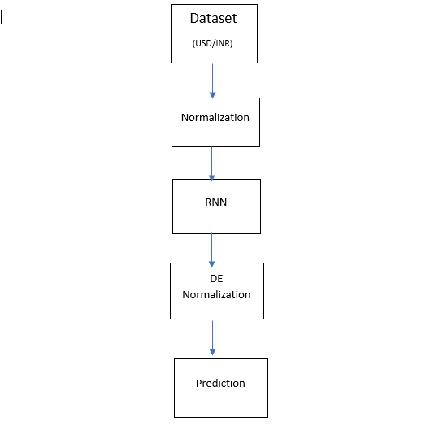
Methodology RNN

Slide 7
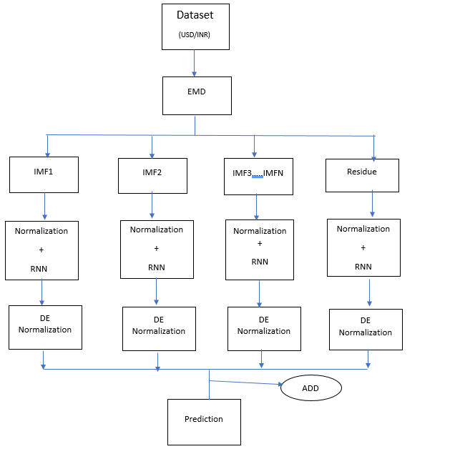
Methodology : EMD +RNN

Slide 8
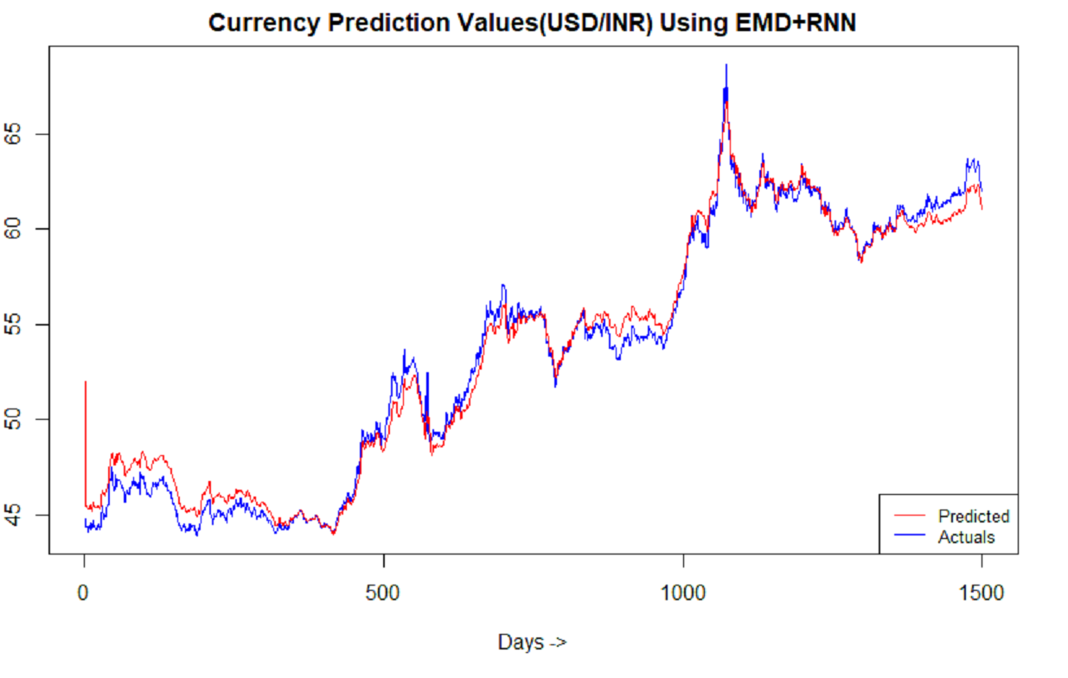
Results: RNN + EMD (Window size = 1 day)

Slide 9
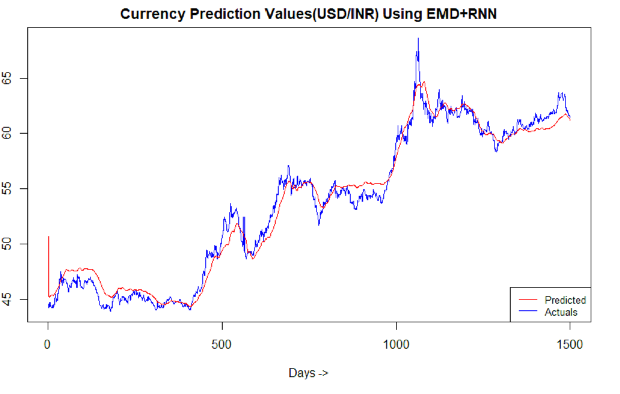
Results : RNN + EMD (Window size = 100 days)

Slide 10
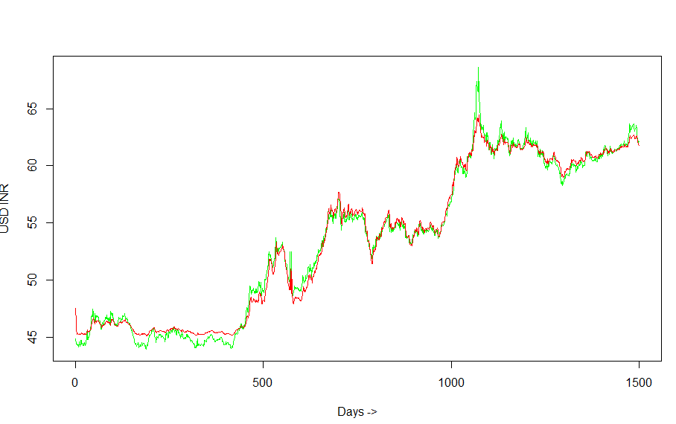
Results : RNN ( Window size = 1 day)

Slide 11
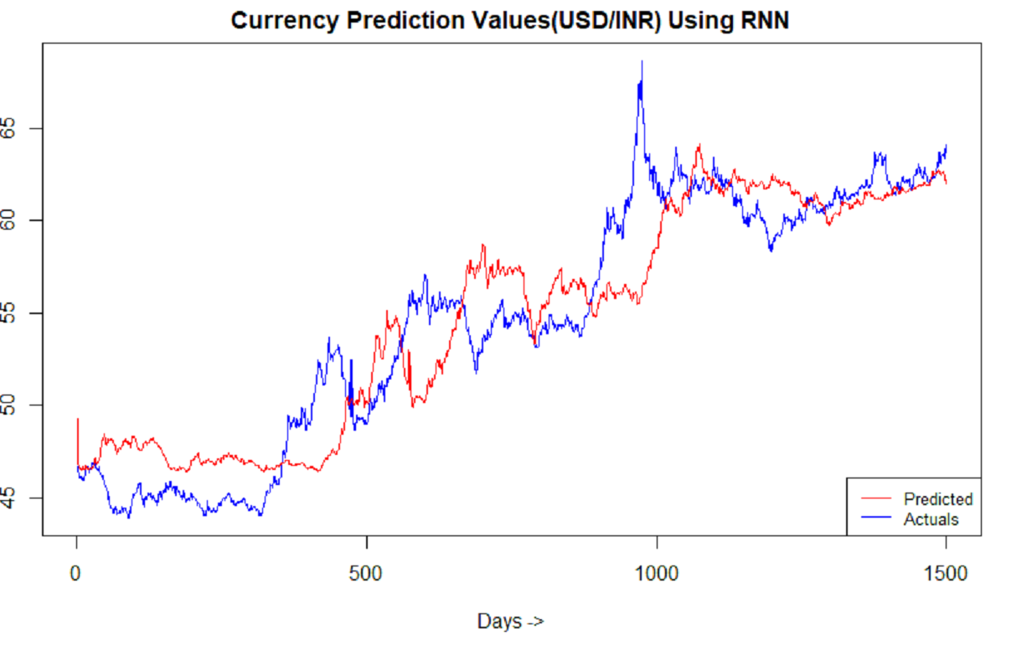
Results: RNN (Window Size = 100 day)

Slide 12
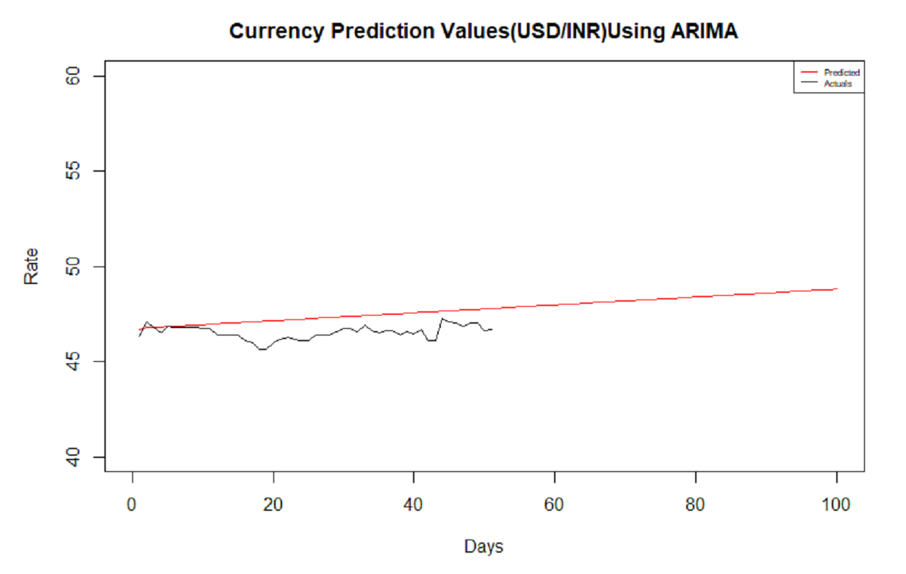
Results : ARIMA (Window size = 100 days)

Slide 13
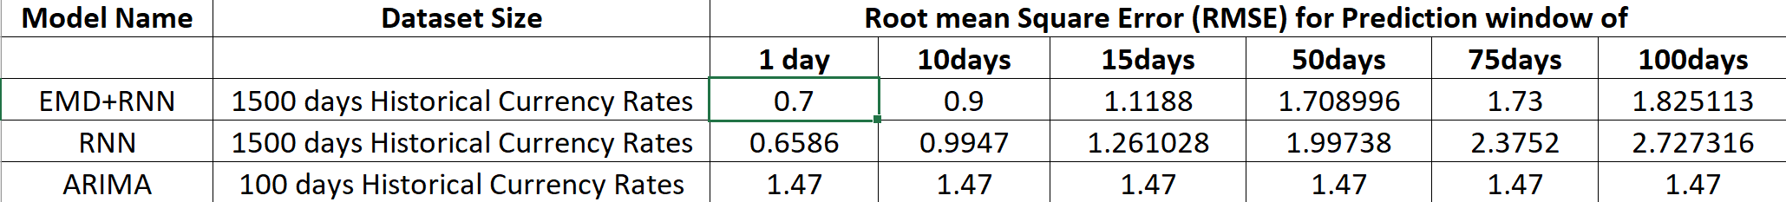
Analysis : RMSE (Root Mean Square Error)

Slide 14
Conclusion & Future Recommendations
EMD + RNN model was the best among the other chosen models which are Raw RNN and ARIMA for long term prediction
Performance : RNN + EMD > RNN > ARIMA
Possible Future Work :
Training the RNN model for a short term prediction
Training ARIMA for large datasets

Slide 15
Demo

Slide 16
Questions?

Slide 17
Thank You!

